Slide 1
Summary of Skin Tx
Recipient: B6
Donor: Balb/c
Groups: Control (MR-1, no IL-10R); Experimental (MR-1 and IL-10R)
Dosing: MR-1: POD 0, 7, 14 (500ug/dose); IL-10R 2mg spread across 6 doses (POD 0, 3, 5, 7, 10, 12)

Slide 2
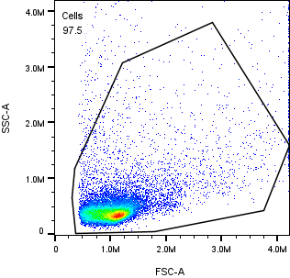
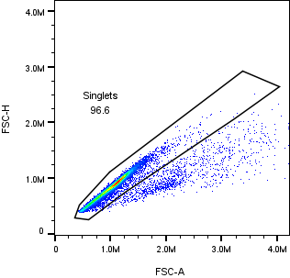
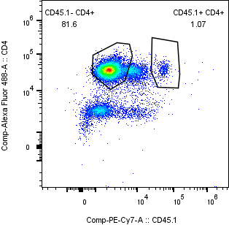
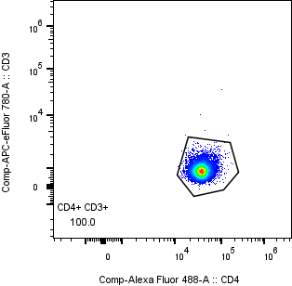
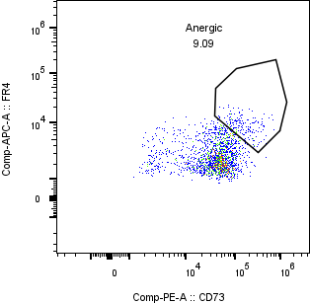
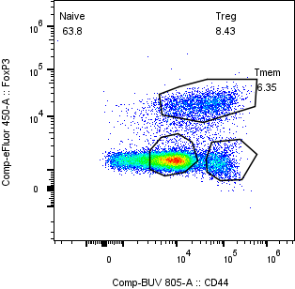
Gating Summary – LN
Notes:
From LN 1

Slide 3
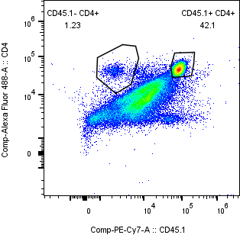
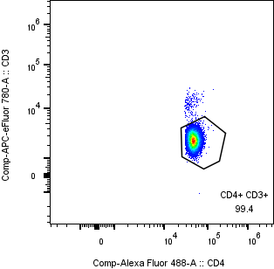
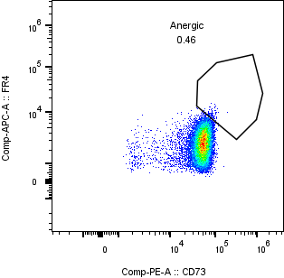
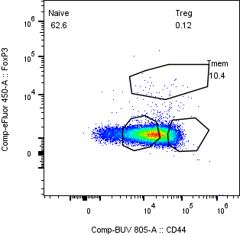
Gating Summary – Spleen
Thoughts on CD44 vs FoxP3 gating?
Notes:
From Spl 1.

Slide 4
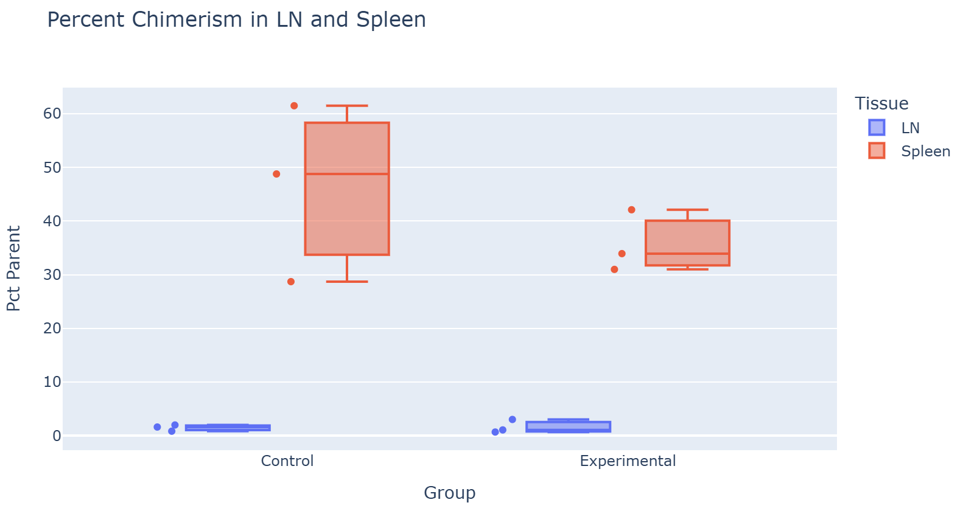
Chimerism – Summary

Slide 5
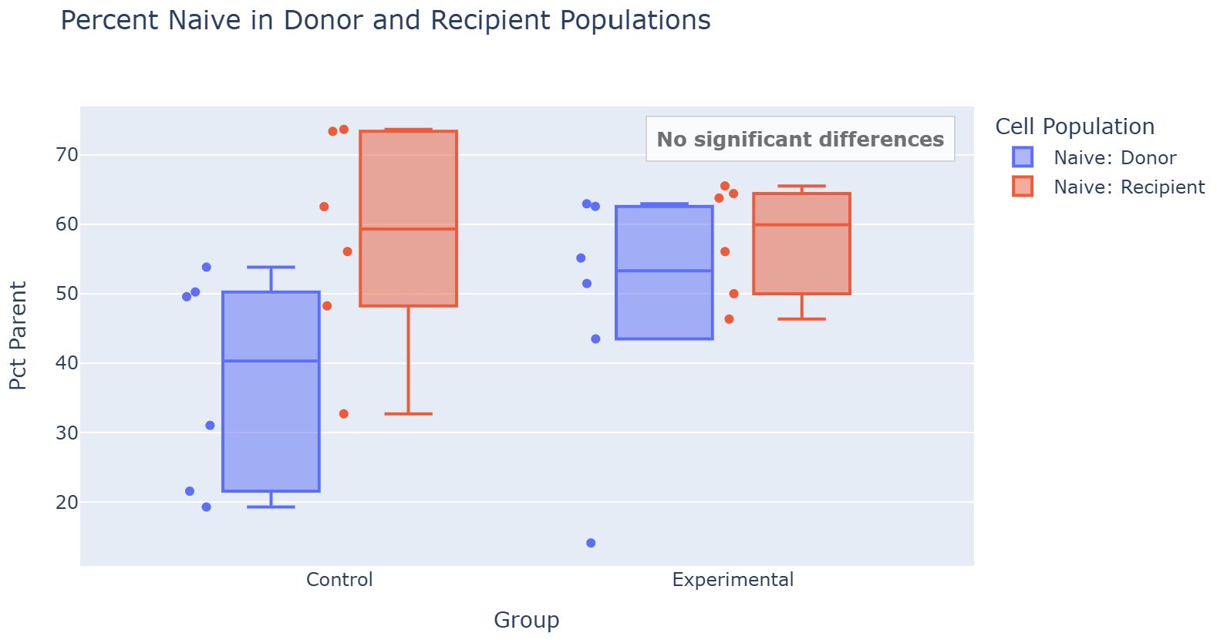
Naive Cells – Summary

Slide 6
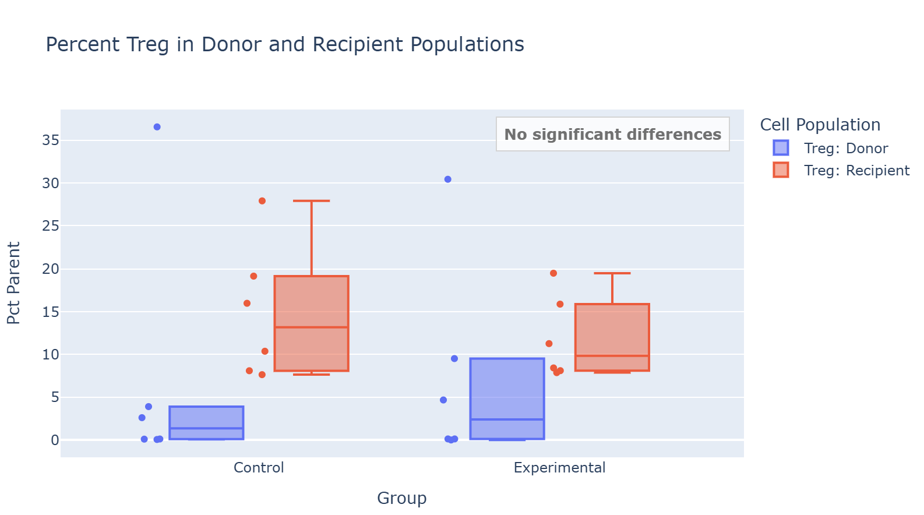
Treg Cells – Summary

Slide 7
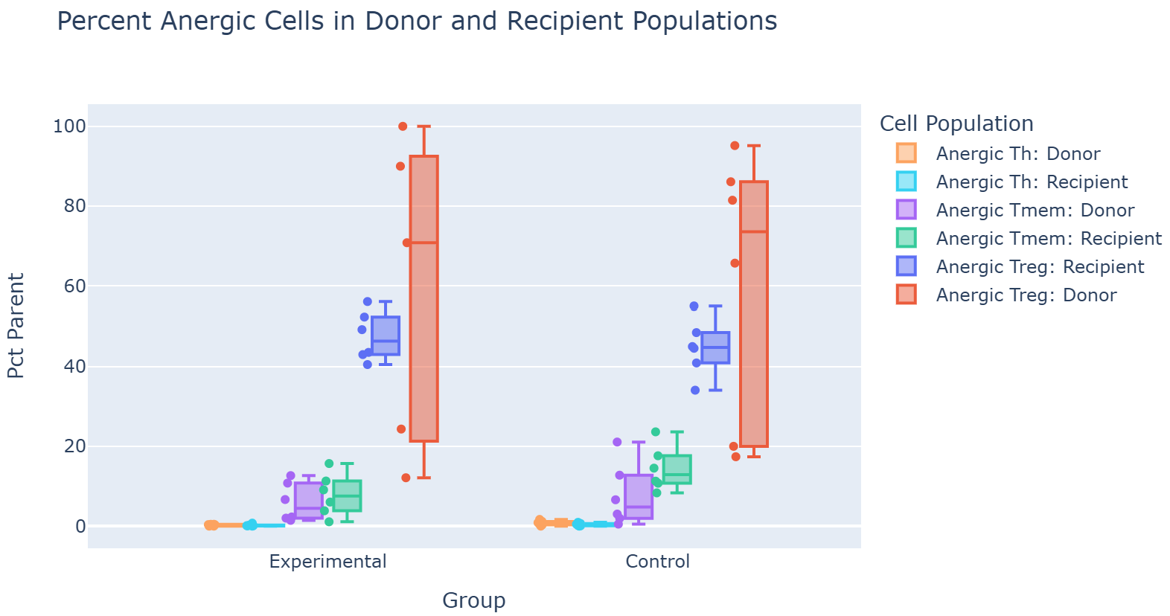
Anergic Cells – Summary
All p-val > 0.05 for Control vs Experimental Cell Populations; Anergic Tmem: Recipient p-val: 0.07

